Slide 1

Databases Overview, Practice (day 4)
PROG102 – Marvin taboada

Slide 2
H2. A Java SQL Database
Very fast, open source, JDBC API
Embedded and server modes; in-memory databases
Browser based Console application
Small footprint: around 2.5 MB jar file size

Slide 3
Spring Boot
Makes it easy to create runnable stand-alone, production-grade Spring based Applications.
An opinionated view of the Spring platform and third-party libraries so you can get started with minimum fuss. Most Spring Boot applications need minimal Spring configuration.

Slide 4
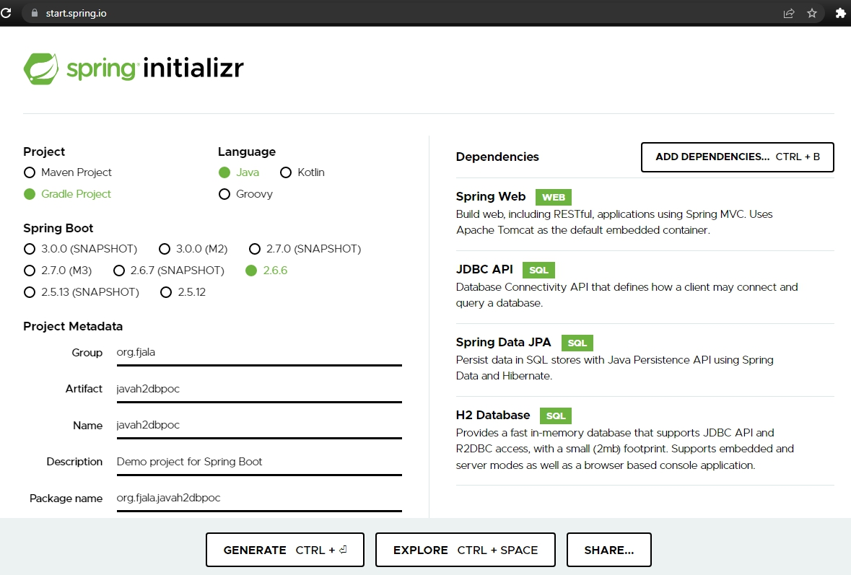
Spring Initializr

Slide 5
Setup Visual Studio Code
Useful extensions:
Extension Pack for Java
Thunder Client

Slide 6
Application Properties
src/main/resources/application.properties:
#Datasource Configuration
spring.datasource.url=jdbc:h2:mem:jdbcpocdb
spring.datasource.driverClassName=org.h2.Driver
spring.datasource.username=sa
spring.datasource.password=passwd
#JPA Configuration
spring.jpa.database-platform=org.hibernate.dialect.H2Dialect
spring.jpa.hibernate.ddl-auto=update
#H2 Configuration
spring.h2.console.enabled=true
spring.h2.console.path=/h2-console

Slide 7
Run the Application, Browse the H2 Console
Build and run the application
$ ./gradlew bootRun
Browse the H2 Web Console
http://localhost:8080/h2-console

Slide 8
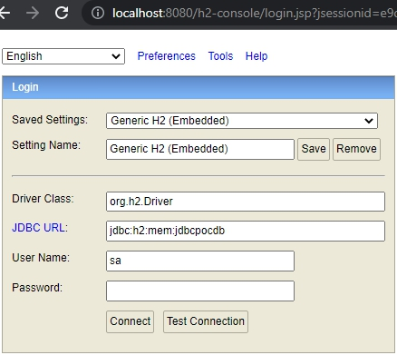
H2 Console

Slide 9
H2 Practice
Create a table “Student“ with attributes:
id:integer
first_name: varchar(100)
last_name: varchar(100)
age: integer
Insert 3 student records
Select 2 students records based on age
Delete a student by id
Select all remaining students
Send all queries by email for review

Slide 10
References
https://www.h2database.com/html/main.html
https://spring.io/projects/spring-boot

